Slide 1

Cyanide Toxicity
Matthew P. Davey, MD
Medical Toxicology Fellow
Oregon Health and Science University
Oregon Poison Center
Notes:
Alright, here’s a nice picture of our quiant little city all lit up with a snowy Mt Hood in the background. Ok we better get started again. I’d like to talk to you know about cyanide toxicity, how to diagnose it and how to manage it.

Slide 2
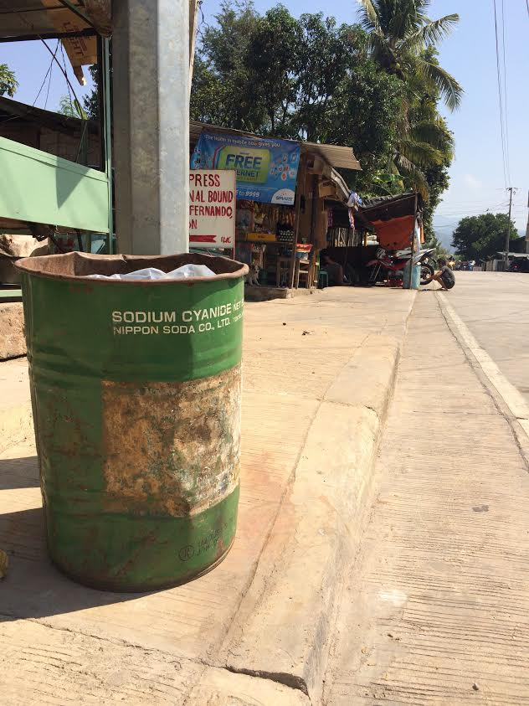

Cyanide Fishing
Notes:
But before starting I just wanted to show you a couple of cool pictures, revolving around cyanide. The first on the left here you can see a large old 55 gallon drum of sodium cyanide that I came across when traveling to the Phillippines earlier this year. In the Phillipines, as well as other countries and SE Asia and really all over tropical reefs, people have used sodium cyanide as a way to fish for exotic tropical fish. Spraying the cyanide like you see here, stuns the fish, enabling the person to capture expensive aquarium fish without killing them. Unfortunately, as you can imagine, as part of the process, a large amount of coral reef and other marine life are damaged.

Slide 3
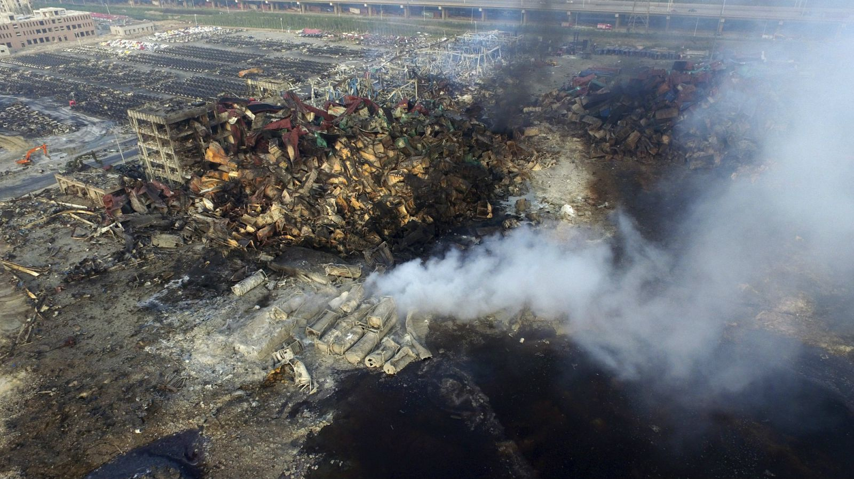
Cyanide Explosion
Notes:
So here is our case. This is the recent case that I’m sure you’ve seen in the media. It was one of a large explosion at a container storage site that was said to hold up to 700 tons of sodium cyanide among others including ammonium nitrate and potassium nitrate. The explosion caused damage up to 2km away, caused over 40 deaths. People days later continued to have upper airway irritation, raising concerns for inhalational and drinking water exposure to sodium cyanide among many other toxic substances.

Slide 4
Cyanide Explosion
Notes:
Here is a video of the explosion which is incredibly impressive.

Slide 5
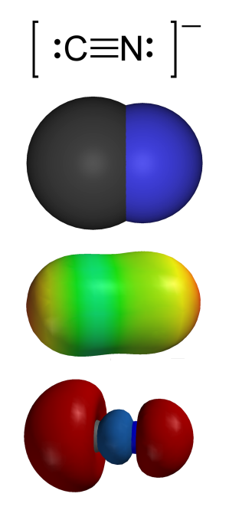

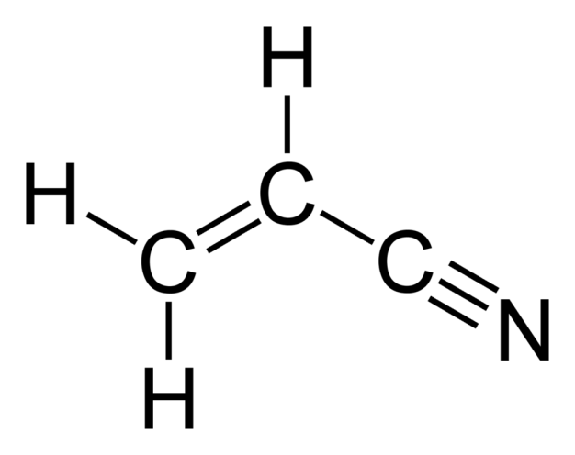
Chemical Structure
Cyanide
Nitrile (acrylonitrile)
Can come as hydrogen cyanide (HCN; gas or liquid) or various salts (ie. Potassium cyanide)
Used as a monomer in manufacturing plastics and rubbers (ie. Polyacrylonitrile)
Notes:
So let’s start quickly at the beginning. Cyanide is a simple molecule of 1 carbon and 1 nitrogen. Cyanide usually comes in the form of hydrogen cyanide gas or as a salt such as sodium or potassium cyanide. There are also nitriles or cyanogenic compounds, such as acrylonitrile or acetonitrile that are able to release the cyanide molecule. These are often used in the chemical manufacturing of other chemicals and polymers. As you can imagine, these require metabolism to release the cyanide ion.

Slide 6

Sources of Cyanide
Smoke Inhalation
House fires
Combustion of many household products
  Wool
  Silk
  Synthetic rubber
  Polyurethane products
    all release cyanide upon burning
Notes:
It’s important to know in what context we will see cyanide. In the US, the combustion of household products and smoke inhalation from house fires is the major cause of cyanide toxicity. This is the release of cyanide molecules from many different synthetics such as rubbers and polyurethane products. I’m assuming that this is similar in Thailand, so I would be interested to know if you have similar experiences here.

Slide 7
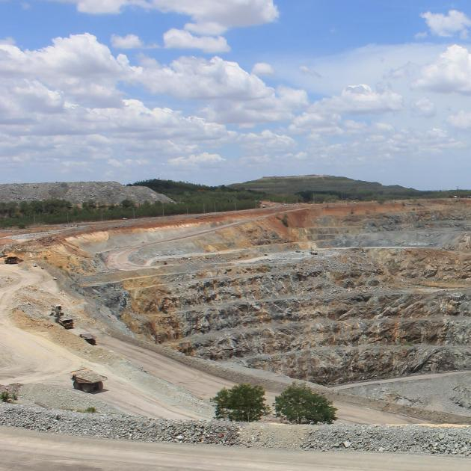
Sources of Cyanide
Industrial Accidents
Chatree Gold Mine, Phichit
Highly reactive CN⁻ useful in a host of chemical/manufacturing processes
Gold and silver extraction
Recycling of photographic materials
Producers of plastics, pigments, and dyes
Also used as fumigant pesticides
Notes:
In the occupational setting, we see cyanide exposure in various manufacturing of chemicals, plastics, dyes, and at times as a fumigant pesticide. Different mining techniques for gold and silver will use cyanide for extraction. This occurs all over the world. One such mining operation is shown here at the Chatree gold mine near Phichit in central Thailand. There is a fair amount of concern by community members regarding ongoing elevated cyanide air and water levels.

Slide 8
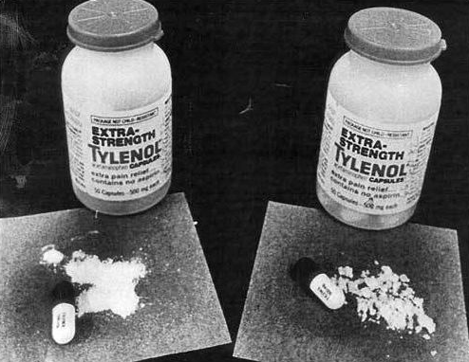
Sources of Cyanide
Suicide, Homicide, Terrorism
Chicago Tylenol Murders
“Jonestown” – religious cult in Guyana where 909 Americans committed mass suicide
Chicago acetaminophen murders
  Cyanide-laced acetaminophen capsules in 1984
Cyanide compounds also found in Tokyo subway bathrooms after sarin attack
Notes:
Beyond the residential and occupational sources, cyanide has a long history of being used a agent of suicide and homicide. The Jonestown mass suicide is perhaps the largest example. The American religious organization under Jim Jones committed mass suicide of over 900 followers using a cyanide they had been collecting under a jewelers’ license to clean gold. In another fascinating American homicide case, an individual that still has not been caught to date replaced acetaminophen capsules with potassium cyanide and then placed them back on the shelf. This ultimately lead to 7 deaths and the change of packaging laws to mandate tamper-resistant packaging that we have today.

Slide 9

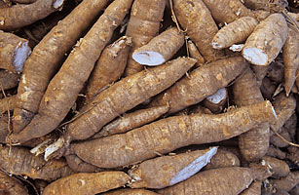



Sources of Cyanide
Pitted fruits
Cassava
Cassava root provides nutrition for millions worldwide
Contains linamarin – cyanogenic glycoside
Soaking in water for 1 day releases 45% of cyanogens – 5 days releases 90%
Pits contain amygdalin that is converted to cyanide by intestinal enzymes
Notes:
The final potential cyanide exposure comes from natural cyanogenic compounds. Pits from pitted fruits contain amygdalin that is converted to cyanide by intestinal enzymes. It should be stated that you must pulverize the pits completely and ingest a large amount to have significant toxicity. The other source is from cyanogenic linamarin found in the cassava root that is used as nutrition from all over the world. The cyanogenic compound is removed with soaking in water, but takes up to 5 days to remove 90%, so toxicity has occurred in the setting of famine and hurried preparation. Do you have a lot of cassava here, have you seen toxicity from it?

Slide 10
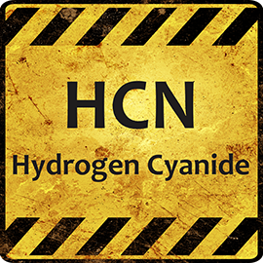
Toxic Levels
Oral KCN lethal dose: 200mg
Inhalational HCN immediately fatal: 270ppm (ug/ml)
Life threatening: >110ppm for greater than 30 min
OHSA PEL is 10ppm for 8h TWA
IDLH for HCN is 50ppm
Notes:
In terms of how much it takes, as you can see, it’s not a lot. The fatal dose of 200mg potassium cyanide is approximately 200mg. In terms of inhalation, the OHSA 8hrPEL is 10ppm, the immediate danger to life and health is 50ppm, and immediately fatal air concentration is 270ppm. Cyanide has quite a dark history being used for executions and mass poisoning where levels are often above 5000-1000ppm.

Slide 11
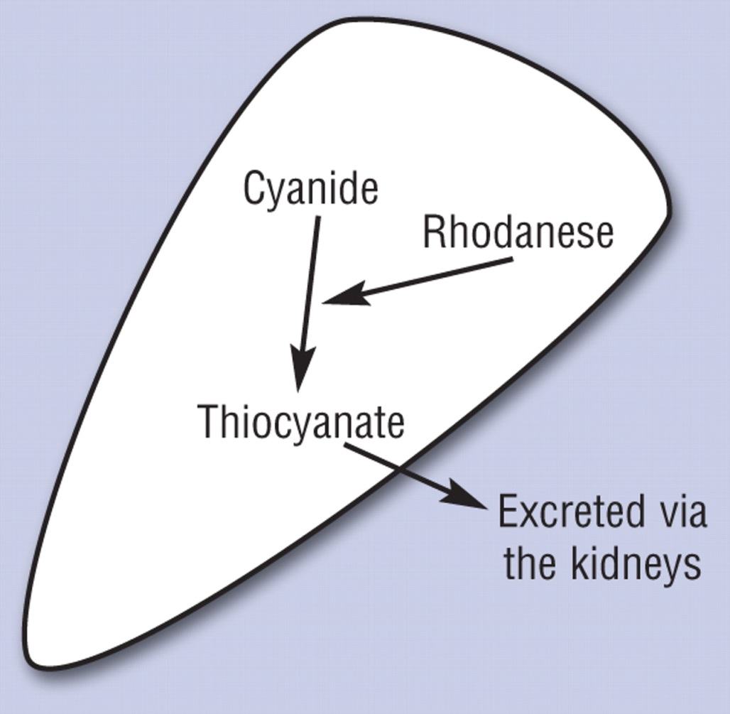
Cyanide (usual) Metabolism
(important for later!)
Crit Care Nurse. 2011 Feb;31(1):72-81
A sulfur donor (thiosulfate) combines with cyanide to form nontoxic thiocyanate
Notes:
So to understand what goes wrong in cyanide, we have to understand how it is supposed to be metabolized. Usually everybody has a very small concentration of cyanide that is easily detoxified. This here shows our endogenous method of removing cyanide - usually coming from cigarette smoke most commonly. The rhodanese enzyme converts cyanide into the nontoxic thiocyanate, but unfortunately this needs a sulfur donor and is easily saturated.

Slide 12
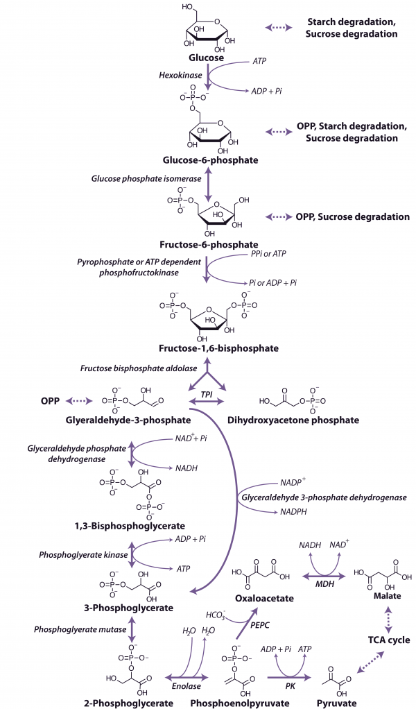
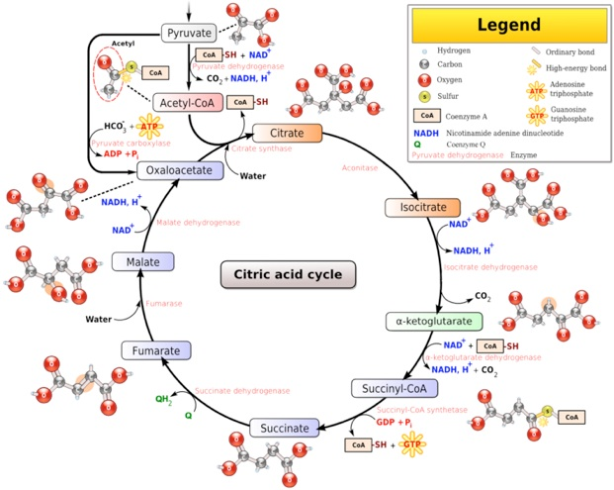
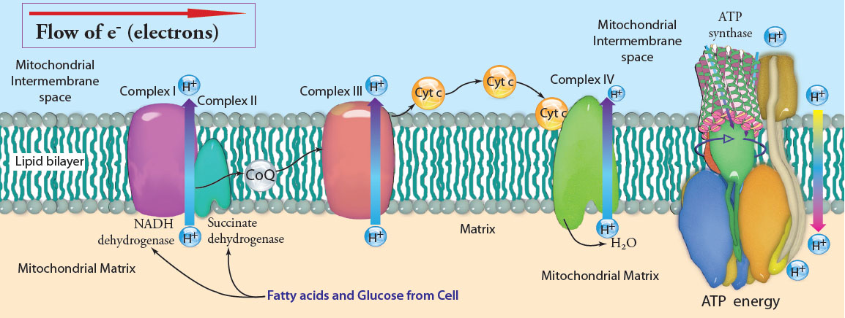
What goes wrong with cyanide?
Notes:
Now here is the pathophysiology of cyanide. This slide is not meant to read or to scare you too much. It’s simply here to show that one way or another cyanide places a part in disrupting glycolysis, the TCA cycle and ultimately the electron transport chain. So instead of getting bogged down in the useless minution of these graphs, lets make it a lot simpler and see when cyanide really acts.

Slide 13
Cyanide Pathophysiology
glucose
LACTATE
pyruvate
Kreb’s Cycle
ATP
CYANIDE
Electron Transport Chain
H⁺
+
O₂
H₂O
Notes:
So here is the graphic I much prefer. As you can see, cyanide inhibit the electron transport chain via cytochrome a3. This leads to a backup of cellular products and causes a conversion of pyruvate to lactate. As you can see, hydrogen molecules are not being incorporated, leading to an acidosis and oxygen is not being used and ATP is not being created. What you are left with is a severe lactic acidosis and cell that cannot use O2 or make ATP.

Slide 14
How does this translate clinically?
Effects every cell undergoing oxidative phosphorylation
  Effects the most oxygen-sensitive organs first
    Basal ganglia
    Cerebellum
    Sensorimotor cortex
    Myocardium
Notes:
Ultimately this leads to multi-organ dysfunction, but it affects the most oxygen-sensitive organs first - which are alway going to be the brain and the heart. Like a lot of other cellular poisons such as hydrogen sulfide and carbon monoxide, the basal ganglia, cerebellum and myocardium are affected first before the other multiorgan dysfunction.

Slide 15
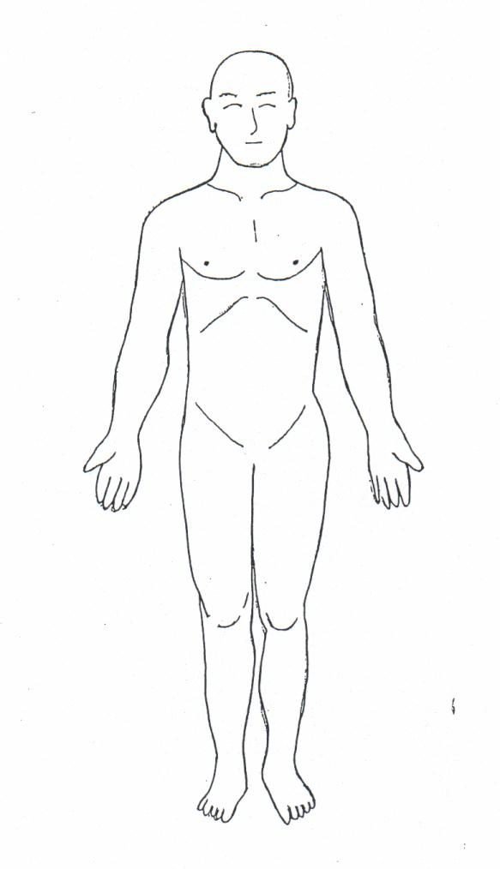
Oxygen-sensitive organs are affected first
Central Nervous System
  Progressive hypoxia, agitation, lethargy, seizures, coma
Cardiovascular
  Initial hypotension and tachycardia
  Terminal bradycardia and hypotension
Notes:
In terms of the actual signs and symptoms you will see, in the central nervous system it will be agitation, lethargy, and ultimately seizure, coma, and then death. Cardiovascularly, you will see hypotension and a compensatory tachycardia, but ultimately a terminal bradycardia.

Slide 16
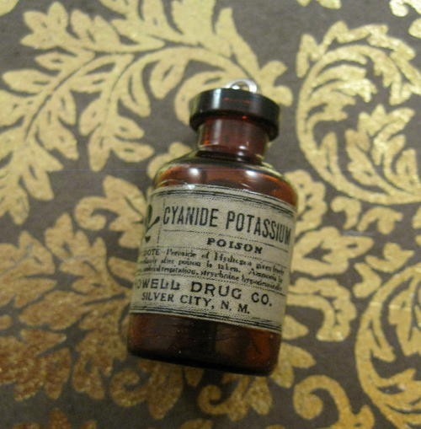
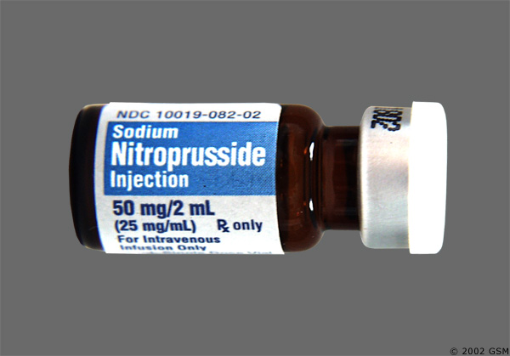
Onset of Toxicity
In general the onset is rapid
  Inhalational or intravenous: within seconds
  Ingestion: within minutes
    Cyanogenic compounds within hours depending of rate of conversion
  Nitroprusside: hours to days of continuous infusion
Notes:
Now the onset of toxicity all depends on the route of exposure. For inhalational or intravenous, you will see severe toxicity within seconds. After ingestion of a cyanide salt, the toxicity is usually within minutes, but can be delayed if ingesting a cyanogenic compound that needs to be converted. Or in the case of a nitroprusside infusion - which also releases cyandie - the build up is usually over many hours to days.

Slide 17
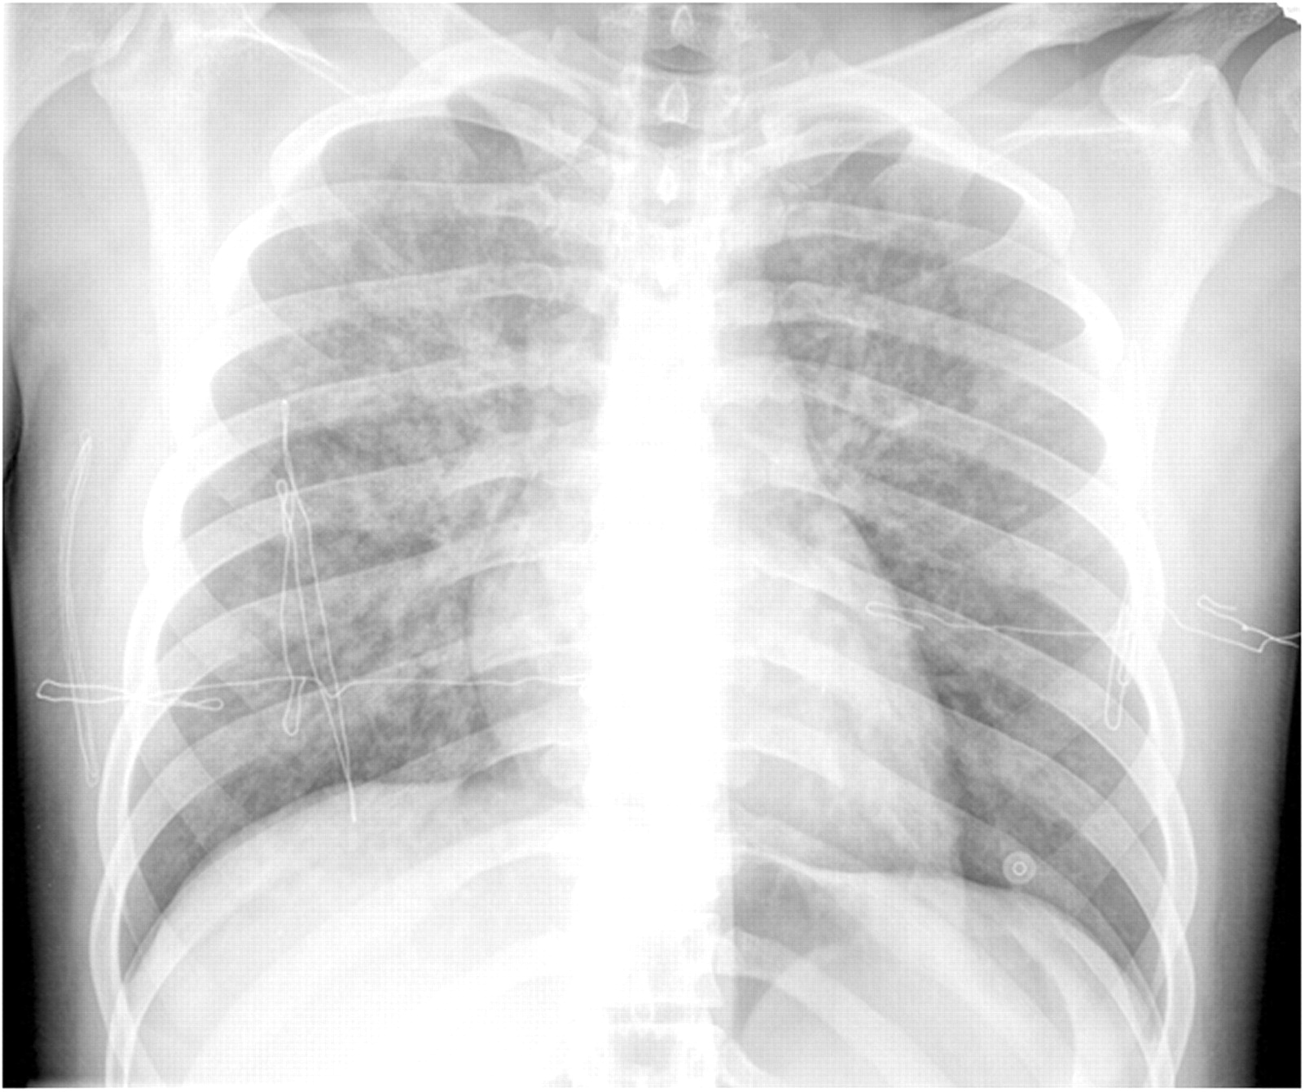
Other organs affected
Pulmonary:
  acute edema with inhalation
Gastrointestinal:
  hemorrhagic gastritis with ingestion
Skin:
  cherry red from increased venous hemoglobin O₂ saturation
Notes:
Other organs are affected secondarily. With inhalation, you can see acute lung injury and pulmonary edema. GI-wise you can see a hemorrhagic gastritis after ingestion. The skin is classically described as a cherry red as the venous oxygen saturation remains very high as it is unable to unload O2 to the tissues. These other manifestations are more rare given the fact that mortality is usually quick leaving little time for these to develop.

Slide 18
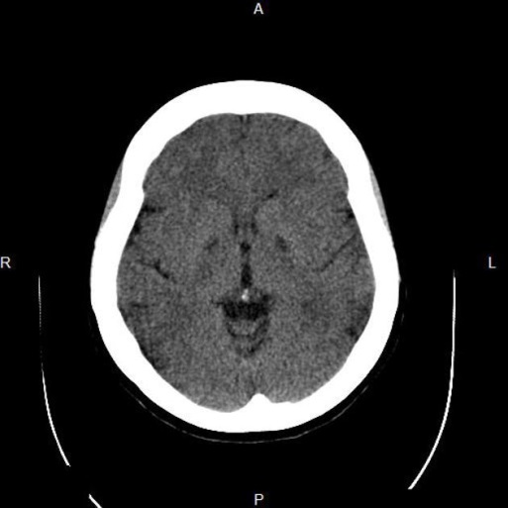
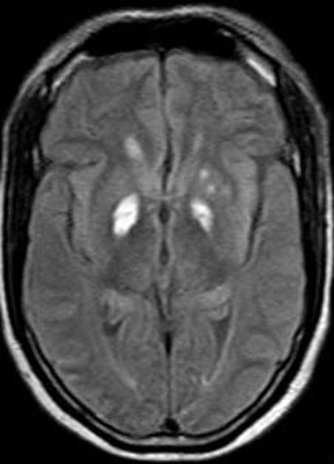
Delayed Neurologic Sequelae
For those that survive the acute toxicity (weeks to months later)
Similar to delayed neurologic sequelae of carbon monoxide poisoning
  Parkinsonian symptoms
  Dystonia
  Dysarthria
  Rigidity
  Bradykinesia
CT/MRI brain with globus pallidus and putamen lesions
Notes:
Just like it other cellular poisons such as carbon monoxide, there are documented cases of delayed neurologic sequelae that occurs weeks to months later. Clinically you can see symptoms of parkinsonism with rigidity and bradykinesia. Radiographically you can see globus pallidus and putamen lesions. Here you see hypodensities in the globus pallidus on the CT above and hyperintensities on the MRI below. Despite all of this, you usually will not see this as either the patient has a mild exposure or a rapidly fatal exposure.

Slide 19

Chronic Toxicity
Tobacco amblopia
  Progressive vision loss in male (less so female) smokers
  Reduced ability to detoxify cyanide from cigarette smoke
  Treatment is smoking cessation and hydroxocobalamin
Notes:
So far we have limited our discussion to mainly the acute toxicity, but there are 3 really fascinating diseases that can be thought of as chronic cyanide toxicity. All have vision loss at least as a component of their disease. The first is tobacco amblopia. This occurs much more frequently in males than females. It is thought to be a progressive vision loss secondary to an inability to fully detoxify the cyanide from tobacco smoke. The treatment is smoking cessation and hydroxocobalamin that we will talk about a little later.

Slide 20
Chronic Toxicity
Tropical ataxic neuropathy
  Demyelinating disease from ??improperly processed cassava root consumption, ?vitamin deficiency
  Elevated thiocyanate levels implicating elevated cyanide levels
  Parkinsonian symptoms, spastic paraparesis, sensory ataxia, optic atrophy, and sensorineural hearing loss
  Treatment: cassava removal, hydroxocobalamin, thiamine
Notes:
The next chronic syndrome is called tropical ataxic neuropathy. It is a demylinating disease without a complete explanation at this time. One of the leading theories has been chronic cyanide toxicity from chronic ingestion of improperly processed cassava. The disease is a constellation of spastic paresis, ataxia, and optic atrophy. The role of cyanide has been questioned as of late, but removal of cassava and administration of hydroxocobalamin, in addition to other vitamins is a reasonable approach. Not practicing in the tropics, I have not actually seen this disease. Has anyone taken care of somebody with this? What did you treat with? Did it get better?

Slide 21
Chronic Toxicity
Leber hereditary optic atrophy
  Subacute visual failure
  Inherited through mitochondrial DNA
  Etiology not clearly elucidated
    NADH dehydrogenase dysfunction
    ??rhodanese deficiency and inability to detoxify cyanide contributory
  Best to avoid smoking
Notes:
Lastly, leber hereditary optic atrophy is a mitochondrial linked mutation associated with subacute vision loss. Onset is usually in late adolescence or in the early twenties. In the past this has been linked with a rhodanese deficiency and inability detoxify cyanide. However, as more genetic testing and research comes out, this appears to be a less likely cause a defect in NADH dehydrogenase and oxidative phosphorylation is the more likely cause. With that being said it is still prudent to counsel you patient to avoid cigarette smoke or any other vision toxin.

Slide 22
Diagnosing Cyanide Poisoning
Have a high index of suspicion
No immediate confirmatory test
Must rely on a combination of historical circumstances and initial lab tests
Notes:
Now that we’ve discussed a lot about the sources of exposure and the pathophysiology we can delve into the diagnosis and management. The key rule of thumb with diagnosis is to always have a high index of suspicion. At our hospital and surrounding hospital there is no easy test for cyanide. Is your hospital any different? Because there is no rapid confirmatory test, we much rely heavily on our history, physical and initial lab tests to make clinical decisions.

Slide 23
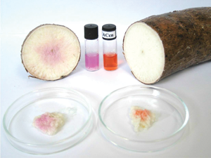
History
Sudden collapse of industrial worker
Fire victim with coma or acidemia
Suicide with unexplained coma or acidemia
Ingestion of artificial nail remover
Ingestion of pits from prunus species
Altered mental status, acidemia, and tachyphylaxis to nitroprusside
Notes:
Here are a list that we’ve made of historical scenarios that should raise a red flag in your mind for possible cyanide toxicity. Several of these are already cases that we’ve talked about including the smoke inhalation victim, the patient that has ingested a large quantity of pulverized pit fruit, and the patient on long term nitroprusside. Additionally, we should think of cyanide in anybody in industry that has a sudden unexplained collapse or anyone with an ingestion of a cyanogenic nail remover.
Here I thought this was just an interesting picture and idea. It is a cyanide home testing kit for your cassava. Once a sufficiently low amount of cyanide is obtained, the dye will turn orange and it can be marked as safe to eat. The pink on the left signifies elevated cyanide levels.

Slide 24
Initial Labs
Metabolic acidosis
Increased anion gap
Elevated lactate
  Direct correlation between lactate and cyanide concentration
BMJ. 1996;312:26-27.
Notes:
Beside the initial history and physical, the initial labs can be very helpful. Namely we want to look at the pH status and the lactate level. Here, in this graphic, you can see excellent correlation with the blood cyanide concentration on the top and the lactate concentration on the bottom. They raise and fall in unison. Thus a lactate level greater than 10mmol/L in the right context would be highly concerning for significant cyanide poisoning.

Slide 25
Additional Testing
High SVC venous O2 >90% demonstrates decreased O2 utilization
  Nonspecific: can also be seen in CO poisoning, sepsis and several other scenarios
EKG with sinus tachycardia, bradydysrhythmias, atrial or ventricular fibrillation
BMJ. 1996;312:26-27.
Notes:
Now we can create the same type of relationship with central venous oxygenation. As was mentioned in the pathophysiology, cyanide inhibits the utilization of oxygen and therefore the venous extraction of oxygen will be low, leading to an increase in central venous oxygen concentration. You can see that here in the graph. In the early time period of cyanide poisoning, the venous O2 jumps up to close to 100%, and then trends back to normal after approximately 5 hours.
An initial EKG can also be of help. The most common dysrhythmia is simple sinus tachycardia, but as oxidative phosphorylation is inhibited in the myocardium, bradydysrhymias, atrial fibrillaion and ventricular dysrhythmias can signal end-stage poisoning.

Slide 26
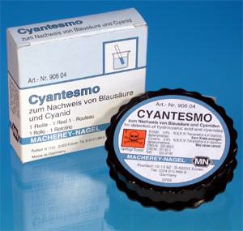
Additional Testing
Cyanide concentrations
  Usually not obtainable in rapid fashion
  Background: 0.02-0.5ug/ml
  Coma/respiratory depression: >2.5ug/ml
  Death: >3ug/ml
Cyantesmo test
  Strips used for water treatment facilities to detect cyanide
  Can rapidly detect CN concentration >1ug/ml in semi-quantitative manner
Notes:
Along with the testing mentioned it is also possible to test for cyanide concentrations in the blood. Unfortunately, at our hospital do not come back in any reasonable amount of time to make initial clinical decisions. If they did, a normal level in you or I would be around 0.02 to 0.5ug/ml. Coma and respiratory depression occur once you get up over 2.5ug/ml, and death is usually imminent at levels over 3ug/ml.
We also do not have this, but there is point of care testing for cyanide. The one shown here is actually intended for testing of treated water, but has also been used for rapid detection of cyanide at the bedside. While this is only a semi-quantitative test, a level of >1ug/dL is consistent with a significant cyanide poisoning.

Slide 27
How to Treat?
First make the diagnosis – have a high index of suspicion!
ABC’s and supportive care
  Early airway management
  Crystalloid boluses and vasopressors for hypotension
  Sodium bicarbonate for severe acidosis
Notes:
Now we can move on to diagnosis and management options. But again, in order to treat, we first have to diagnosis, so it is crucial to keep this in you differential. First and foremost, we are going to treat with good supportive care. Intubating early for expected course, giving intravenous fluid boluses and vasopressors for hypotension. Additionally, for severe, refractory acidosis, we are usually recommending sodium bicarbonate boluses as a temporizing measure.

Slide 28

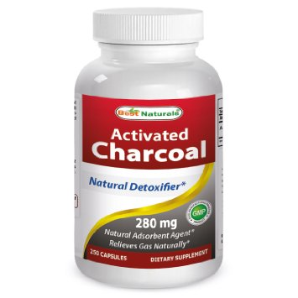
Decontamination
Inhalational exposure:
  Removal from area is critical
Dermal:
  Remove clothing
  Brush off any powder
  Flush skin with water
  Use PPE: water-impervious gowns, gloves, eyewear
Activated charcoal:
  1g/kg only if airway protected
Notes:
In terms of decontamination, as we’ve already learned, in an inhalational exposure, the key to decon is removal of the patient from the source. For a dermally exposed patient, we first want to brush off any remaining powder, followed by copious irrigation with water. For a dermal exposure, providers should be equipped with water-impervious gowns, gloves, and eyewear, but no other special protective equipment is necessary.
Additionally the binding of cyanide salts to activated charcoal is low, but given the small amounts of cyanide that are lethal and relatively large amounts of charcoal that can be given, this is a reasonable option, especially in the acute ingestion. However, given the risk for clinical decompensation, we would recommend having the airway protected prior to giving the charcoal.

Slide 29
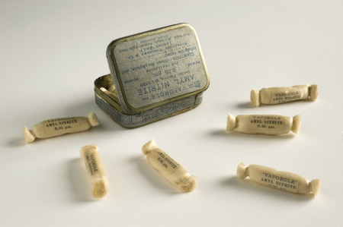
Now the fun part – the antidote(s)
Cyanide Antidote Kit
  Part 1: Amyl nitrite
  Quick way to cause methemoglobinemia if no IV access
  Dose:
    Break 1 ampule, place in front of patient’s mouth – 15 seconds on, 15 seconds off
Notes:
Alright, now for the good stuff, onto the antidotes. As we’ll see, the antidote kit can be hospital specific. Do you know which antidote kit your hospital has...the nitrite/thiosulfate kit or the hydroxocobalamin kit?
So first we’ll go over the cyanide antidote kit which is the nitrite/thiosulfate kit. In the field or in the hospital without IV access you can start with the amyl nitrite poppers as shown here. For dosing, it is 1 ampule broken and then held in front of the patient’s mouth for 15 seconds and then off for 15 seconds. This should be enough to create a low level of methemoglobinemia. Its not immediately obvious why were are trying to create methemoglobinemia so I will clarify a bit more in a minute.

Slide 30
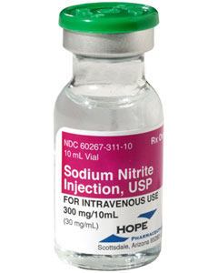
Cyanide Antidote Kit
Part 2: sodium nitrite
  Intravenous way to create methemoglobinemia (within 30 minutes)
  Europe would use 4-dimethylaminophenol (onset much faster – 5 minutes)
  Dose: 300mg (10ml of 3% solution at 5ml/min)
Notes:
Once an IV has been established, the amyl nitrites can be discontinued. In its place you can given intravenous sodium nitrite, again attempting to cause methemoglobinemia. This usually peaks at about 30 minutes. In Europe, they instead would use dimethyaminophenol, which cause a much faster onset to the methemoglobinemia - usually in the first 5 minutes. Do you know what’s in you cyanide kit?
If you are going to go ahead and given sodium nitrite, the dosing is 300mg, which works out to be 10ml of the 3% solution. This shouldn’t be given faster than 5ml/min for the risk of hypotension or excessive methemoglobinemia.

Slide 31

Why Do We Want Methemoglobinemia?
Cyanide preferentially binds to methemoglobin instead of cytochrome a3 in the electron transport chain
Nitrites/methemoglobinemia is contraindicated in other hemoglobinopathies, i.e. carbon monoxide poisonings
Notes:
Ok so what’s the whole idea behind creating methemoglobinemia? Well it turns out that cyanide as you can see here, combines with methemoglobin and forms cyanomethemoglobin that is then able to be detoxified. Cyandie binds much more readily to methemoglobin than to cytochrome a3, which subsequently frees up this to go back to oxidative phosphorylation.
Now an important note is that nitrites and methemoglobin will be contraindicated in other hemoglobinopathies such as carboxyhemoglobinemia. Given that house fires and smoke inhalation is a major source of both cyanide and carbon monoxide, this really limits this kit.

Slide 32

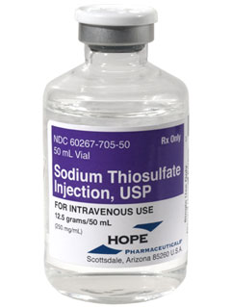
Cyanide Antidote Kit
Part 3: sodium thiosulfate
  Is the sulfur donor in the rhodanese reaction
  Forms thiocyanate which has low toxicity and is renally cleared
  Dose: 12.5g (50ml of 25% solution
Crit Care Nurse. 2011 Feb;31(1):72-81
Notes:
Alright the last part of the cyanide antidote kit is sodium thiosulfate. It works by taking advantage of our endogenous cyanide detoxification pathway. It serves as a sulfur donor for cyanide and is converted to thiocyanate which is relatively nontoxic and is easily renally excreted. The dose of sodium thiosulfate is 12.5g or 50ml of 25% solution.

Slide 33
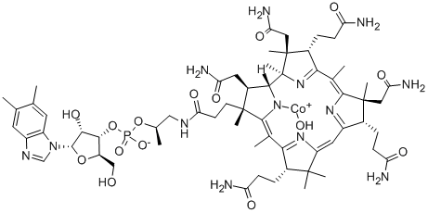
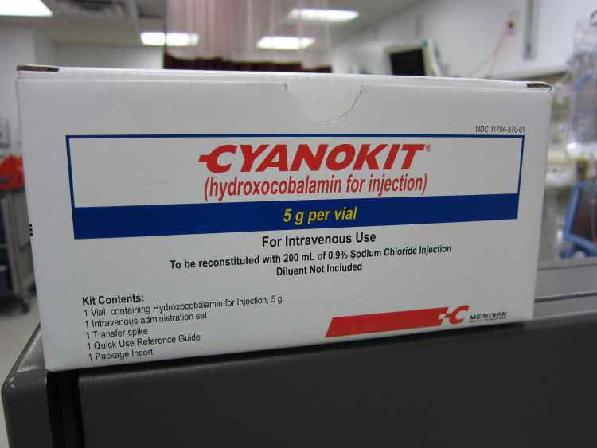
(Not so) New Kid on the Block
Hydroxocobalamin (Cyanokit)
  Huge molecule with a central cobalt that chelates cyanide
  Forms cyanocobalamin (vitamin B12)
  Dose: 5g (in 250ml)
    Intravenous only
Notes:
So clearly we can see some disadvantages and contraindications with the nitrite kit, and so instead the cyanokit or hydroxocobalamin was created. Hydroxocobalamin as you can see is a giant molecule with a central cobalt that chelates the cyanide. Plain cobalt salt was actually tried in the past that was efficacious but associated with a wide range of adverse effects. The hydroxocobalamin combines with cyanide to form cyanocobalamin or vitamin B12, which is pretty ingenious. The dose here is 5g in a volume of 250ml, which really limits ability to be given any other route than intravenous, which can be seen as a big down side in a mass casualty event.

Slide 34
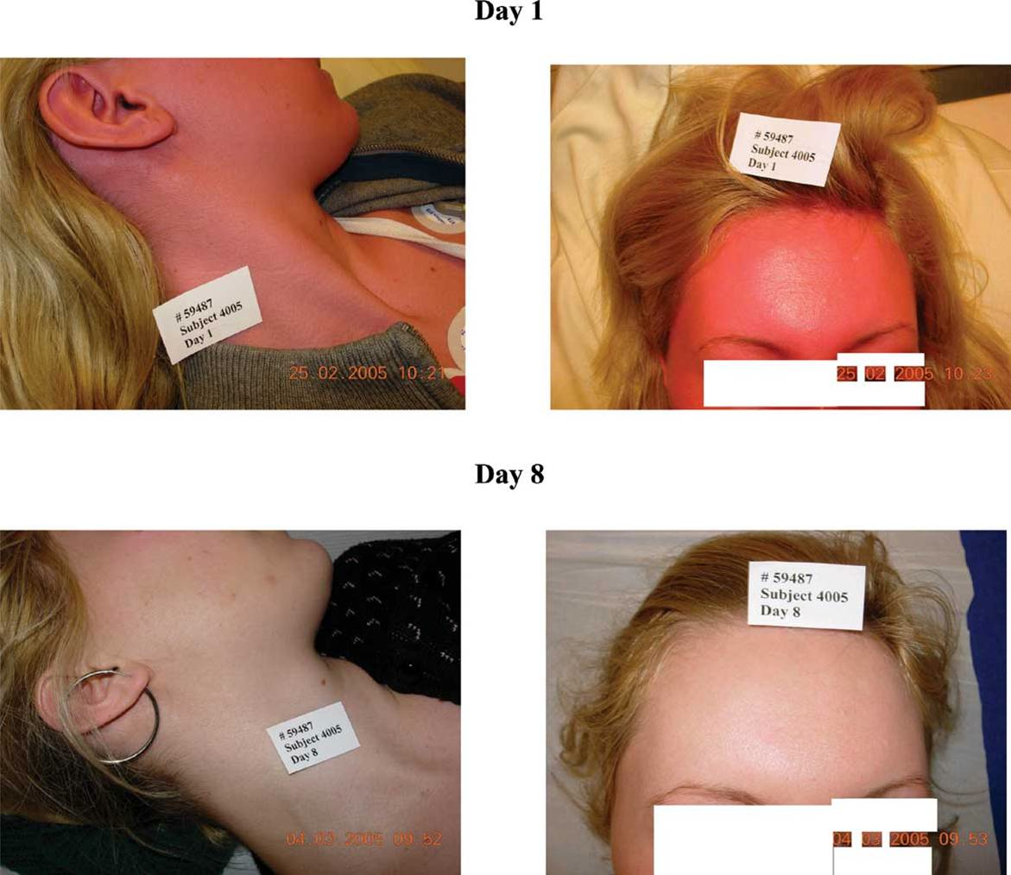
Hydroxocobalamin
Causes reddish discoloration of skin and all body fluids
  Usually lasts 12hours to several days
Color interferes with colorimetric labs
  Including carbon monoxide concentrations
  Try to draw blood prior to initiating
Also can alarm the dialysis blood leak detector
  Dialysate will also turn red
Notes:
The hydroxocobalamin is not without its own drawbacks. It is a bright red substance and can therefore cause this bright reddish skin and body fluid discoloration that you can see here on the right. This usually lasts anywhere for 12hours to several days. As you might imagine, this discoloration also interferes with all colorimeteric lab tests including carbon monoxide. Depending on the machine, the carboxyhemoglobin level can be falsely depressed or elevated. And one last adverse event to hydroxocobalamin is that is cases dialysis units to alarm is if there is a constant blood leak, which is not surprising as the hydroxocobalamin also turns the dialysate red.

Slide 35
Hydroxocobalamin
Also chelates nitric oxide – causes vasoconstriction and increase in blood pressure
  Can use to monitor treatment response
In massive exposures 5g may not be enough to chelate all cyanide
  OK to give a second 5g dose if first dose insufficient
Notes:
A couple of other points to note about hydroxocobalamin are shown here. In addition to cyanide, it also chelates nitric oxide, which can cause some vasoconstriction and increase in the blood pressure. This is probably an excellent thing in anybody you are giving it to. And then just realized that 5 grams may not be enough to chelate all of the cyanide and so repeat dose of 5grams may be indicated if the 1st one only had subpar results.

Slide 36
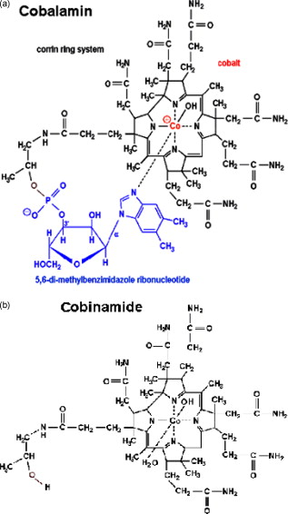
Future Therapies
Cobinamide is a precursor to cobalamin
Has a much greater affinity for cyanide compared to cobalamin
  Only investigational at this time
  Potential huge advantage is its smaller volume
    Can give it intramuscular which is key for mass casualty events!
Notes:
So we mentioned the drawbacks of the two current cyanide treatment kits. So we should keep our eye out for up and coming treatments. One of them that is only in the investigational form right now is cobinamide. As you can see its on the bottoma and cobalamin is the on the top, they are almost identical in structure. The promising thing about cobinamide is that is has a much higher affinity for cyanide and can therefore by given in smaller volumes and potentially intramuscularly which would have a huge impact in mass casualty events.

Slide 37
Cyanide Summary
High index of suspicion
Know the high risk patient
Know the initial lab abnormalities
Know what antidote your hospital stocks and its side effect
Keep an eye out for future therapies
Notes:
Ok, so that pretty much brings us to the end of cyanide. But we can just close with a quick summary slide here. Always have a high index of suspicion for cyanide especially as dictated by your history and initial labs. Know what your hospital stocks and the advantages and disadvantages of both current kits. And keep an eye out for future therapies that might be able to be given intramuscularly in mass casualty events.

Slide 38

Questions?
Notes:
Ok, and with that I can open it up to see if there are any additional questions. Thanks!

